Slide 1
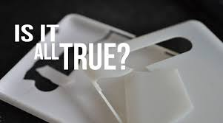
3D PRINTING
3 D Printing
A New revolution in printing Technology

Slide 2
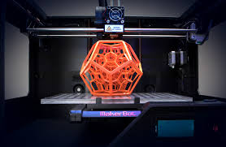
Contents
What is 3D printing ?
How does 3D Printing work?
Methods and technologies of 3D Printing
Applications
3D Printing Services
Future

Slide 3
3D Printing
3D printing is a process of making three dimensional solid objects from a digital file.
It’s an additive process of creating an object by laying down successive layers of material until the entire object is created.

Slide 4
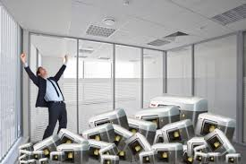
How 3D Printer Works
Making virtual design of the object
This can be made in a software kind of CAD or MAYA
Then we need to design a digital file for the model which we create.
When the model is created it’s created as a horizontal layers and printer reads every horizontal layer and created the object as 3D view

Slide 5
Technologies used in 3D Printing
SLS(Selective Laser Sintering)
-- This technology uses a high power laser to fuse small particles of plastic, metal, ceramic or glass powders into a mass that has the desired three dimensional shape.
FDM(Fused Deposition Modeling )
--The FDM technology works using a plastic filament or metal wire which is unwound from a coil and supplies material to an extrusion nozzle which can turn the flow on and off. The nozzle is heated to melt the material and can be moved in both horizontal and vertical directions by a numerically controlled mechanism, directly controlled by a computer-aided manufacturing (CAM) software package.

Slide 6
Technologies used in 3D Printing
SLA(Stereolithography)
--The main technology in which photopolymerization is used to produce a solid part from a liquid is SLA. This technology employs a vat of liquid ultraviolet curable photopolymer resin and an ultraviolet laser to build the object’s layers one at a time.

Slide 7
Applications
Design visualization,
Prototyping/CAD,
Metal casting,
Architecture,
Education,
Geospatial,
Healthcare
Entertainment
Retail.

Slide 8
3D Printing Services
There are 3D printing service bureaus like Shapeways andPonoko that can very inexpensively print and deliver an object from a digital file that you simply upload to their user-friendly website

Slide 9
Future
3D printers capable of outputting in colour and multiple materials already exist and will continue to improve to a point where functional products will be able to be output.
With effects on energy use, waste reduction, customization, product availability, medicine, art, construction and sciences, 3D printing will change the manufacturing world as we know it.

